Slide 1
Pre-event Webinar & Workshop: October 2021 OGC API Virtual Code Sprint
October 19, 2021
#OGCAPI

Slide 2
Agenda
Welcome
Overview of OGC API – Discrete Global Grid Systems
Overview of OGC API – Common
Overview of Testbed-17 API Experiments
Questions & Answers

Slide 5
Welcome
OGC invites you to the October 2021 OGC API Virtual Code Sprint, to be held virtually on:
Day 1: Tuesday 26 October from 07:00am to 05:30pm EDT.
Day 2: Wednesday 27 October from 07:00am to 05:30pm EDT.
Day 3: Thursday 28 October from 07:00am to 05:30pm EDT.
What is an OGC Code Sprint?
A collaborative and inclusive event driven by innovative and rapid programming with minimal process and organization constraints to support the development of new applications and open standards.

Slide 6



Motivation
APIs are a popular, effective method for rapid software development
There is an increasing need for interoperability between Web APIs
The growing uptake of location within and beyond geospatial developer communities

Slide 7
Sprint Description
The scope of the code sprint is to include:
API implementation
API testing and feedback
Discussion and knowledge sharing
Participants are welcome to bring partial or complete implementations of servers or clients to support the sprint.
Participants will have the opportunity to experiment with parts of the specifications and develop working implementations.

Slide 8
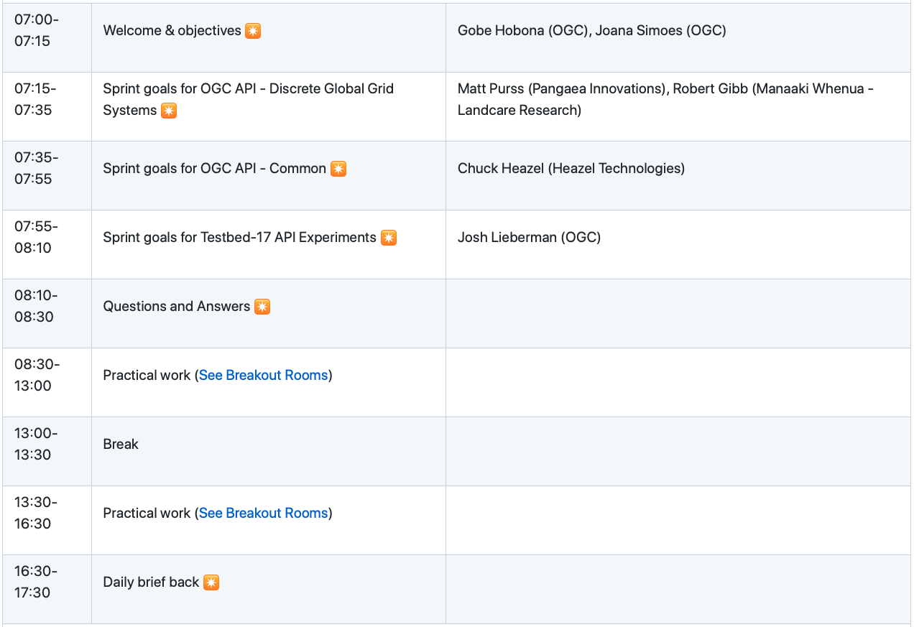
Sprint Schedule – Day 1 – October 26
Notes:
All times are in EDT

Slide 9
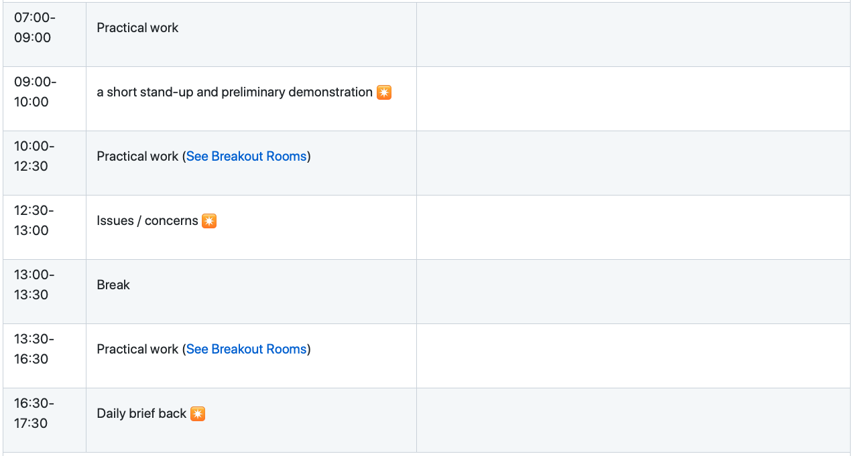
Sprint Schedule – Day 2 – October 27

Slide 10
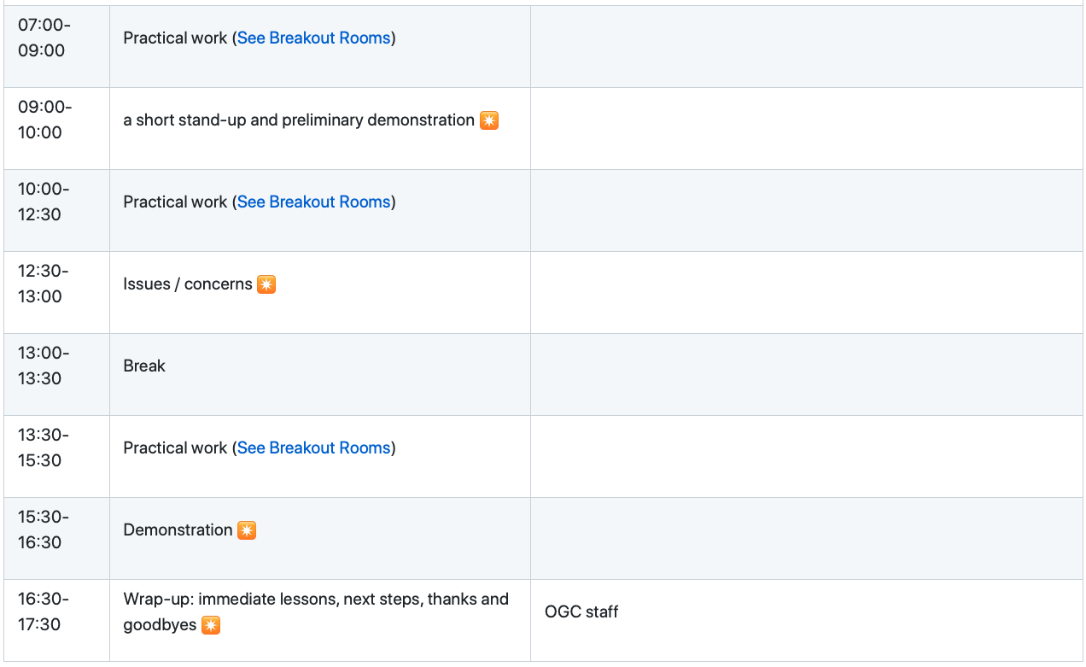
Sprint Schedule – Day 3 – October 28

Slide 11
Logistics
Gotomeeting
Link to be provided to registered participants only.
Gitter
https://gitter.im/ogc-developer/Sprints
GitHub
Sprint repo https://github.com/opengeospatial/ogcapi-code-sprint-2021-10

Slide 12
Overview of the draft specification
OGC API – Discrete Global Grid Systems

Slide 13
Overview of the draft specification
OGC API – Common

Slide 14
Overview
Testbed-17 API Experiments

Slide 15
Q&A
Any Questions?

Slide 16
Community
500+ International Members
110+ Member Meetings
60+ Alliance and Liaison partners
50+ Standards Working Groups
45+ Domain Working Groups
25+ Years of Not for Profit Work 10+ Regional and Country Forums
Innovation
120+ Innovation Initiatives
380+ Technical reports
Quarterly Tech Trends monitoring
Standards
65+ Adopted Standards
300+ products with 1000+ certified implementations
1,700,000+ Operational Data Sets Using OGC Standards
Contact info@ogc.org to schedule a meeting for an in-depth discussion with OGC staff and join our community today!

